Slide 1

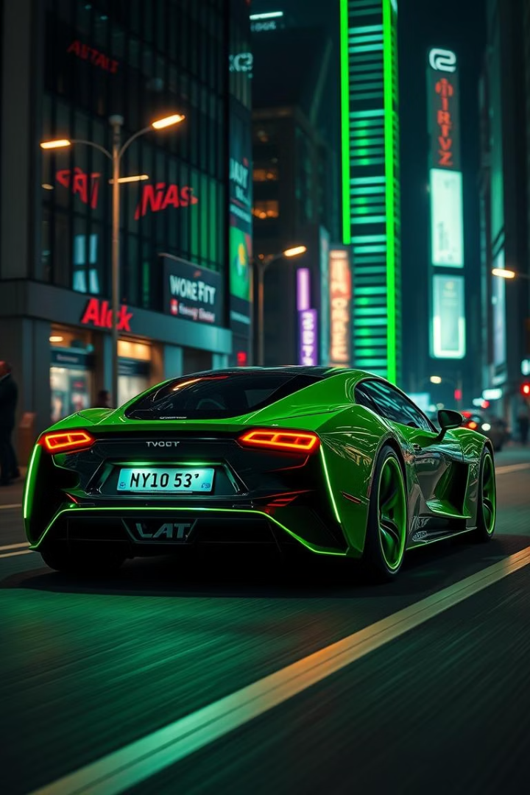
Car Plate Recognition System
Prepared by : Darw Kamal & Ahmed Jabar & Muslim Mahmood & mohammed Twana
Supervised by: Yusra Mohammed
Notes:
1

Slide 2
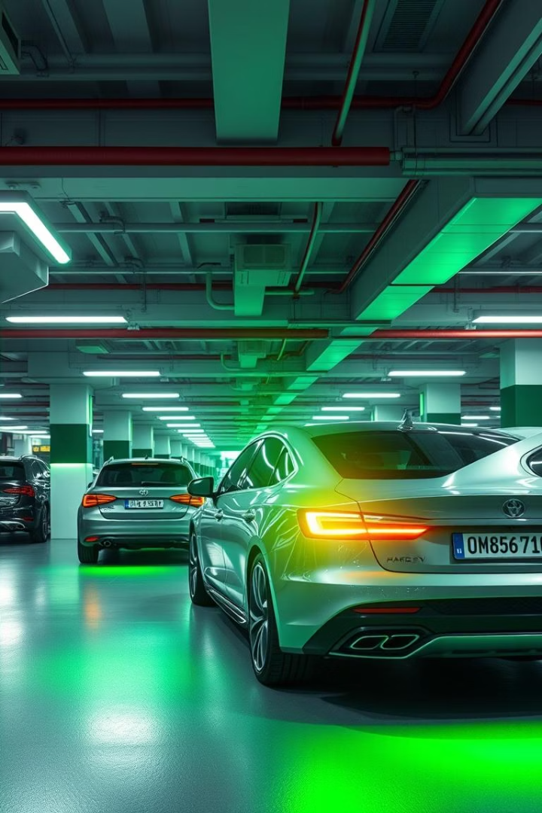
Project Overview
This Java-based system recognizes car license plates. It uses image processing and OCR. Applications include smart parking and surveillance.
Java-Based System
Image Processing & OCR
Developed using Java for robust functionality.
Extracts plate numbers from images.
Versatile Applications
Ideal for smart parking and toll booths.
Notes:
2

Slide 3






Technologies Used
Our system leverages a stack of reliable technologies. Java provides the core programming. Tesseract handles advanced OCR capabilities. NetBeans ensures a smooth development environment.
Language: Java
GUI: Java Swing
OCR: Tesseract
Core programming language.
For user interface design.
Optical Character Recognition.
IDE: NetBeans
Integrated Development Environment.
Notes:
3

Slide 4





System Workflow
The system follows a clear, five-step process. This ensures accurate license plate recognition. Each step builds on the previous one.
Capture Vehicle Image
Initial image acquisition.
Detect License Plate Area
Isolating the plate region.
Preprocess Image
Enhancing image quality for OCR.
Apply OCR to Read Plate
Character recognition.
Display/Store Result
Outputting the recognized plate.
Notes:
4

Slide 5
Sample Output
"Detected plate with recognized text"
Clear Detection
Precise Recognition
User-Friendly
The system accurately identifies the plate within the image.
The GUI presents results clearly.
OCR extracts characters with high fidelity.
Notes:
5

Slide 6
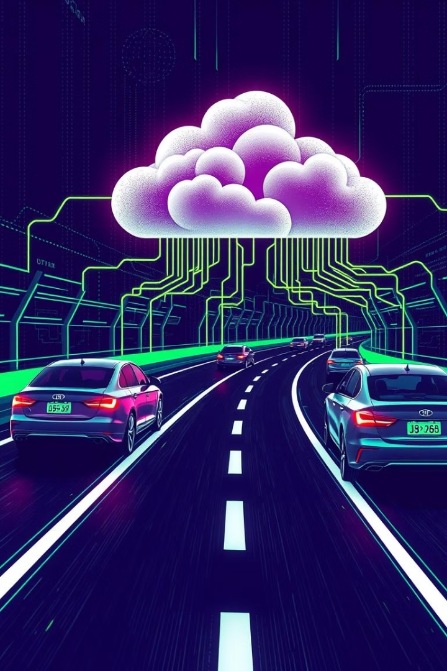



Conclusion & Future Work
We have a working Java prototype for plate recognition. Future work will focus on expanding capabilities. This includes real-time processing and database integration.
Working Prototype
Java-based system is functional.
Real-time Video Input
Enhancing live processing capabilities.
Database Integration
For data storage and retrieval.
Notes:
6

Slide 7
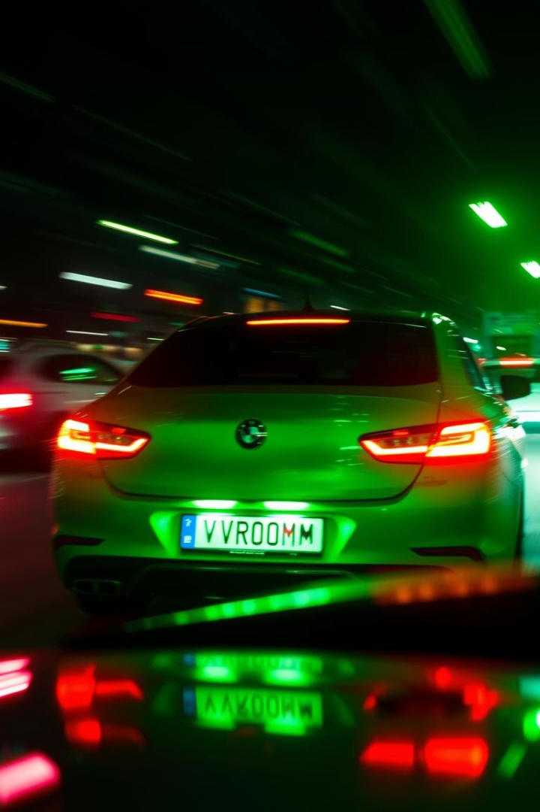
Challenges
The system faces several recognition challenges. These include image quality issues. Variations in license plates also pose difficulties for OCR.
Low-light/Blurry Images
Misread Characters
OCR errors, like '0' vs 'O', '1' vs 'I'.
Degraded image quality impacts detection accuracy.
Plate Variations
Different fonts, colors, and languages.
Notes:
7

Slide 8
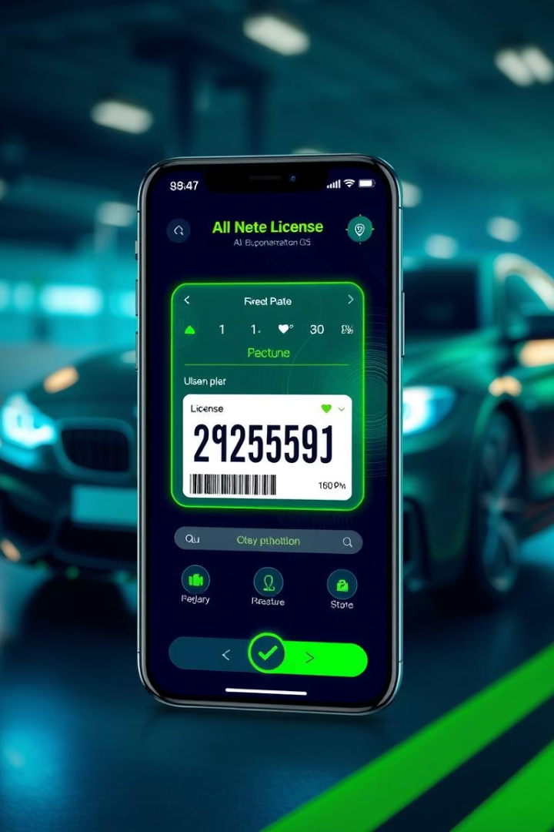
Future Scope
Our prototype is a strong foundation. Future work focuses on advanced features. This includes real-time processing and mobile access.
Real-time Video Support
Enabling live stream recognition.
Plate Validation Logic
Implementing rules for accuracy.
Cloud/Database Integration
For scalable data management.
Mobile App Version
Expanding accessibility to mobile devices.
Notes:
8

Slide 9
Thank you!
Notes:
9

